Slide 1
Exploratory Data Analysis of Housing Dataset
Presented By :DIVYA PRASATH R.S
Batch: DA&DS-MAY’25
Guided By: RAMYA M
Date:26/07/2025

Slide 2
Agenda
Introduction
Data Understanding
Data Cleaning
EDA and Data Visualization
Feature Engineering
Insights
Conclusion

Slide 3

Introduction
Here I have Analyzed housing dataset to identify factors influencing property prices.
Objective: Discover insights to predict property values and assist stakeholders.

Slide 4
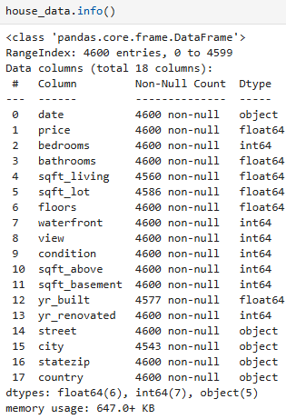
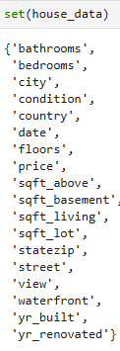
Data Understanding
Dataset: We use Housing CSV file.
This File contains Thousands of property records.
Key Columns: price, sqft_living, bedrooms, bathrooms, yr_built, renovations, grade.
Data types: numerical, categorical, datetime.
It has 4600 Rows and 18 Columns

Slide 5

Data Cleaning
Ensures accuracy, consistency, and reliability.
Missing Values Imputation
Outlier Treatment
Handling Inconsistent Values

Slide 6
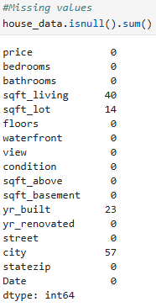
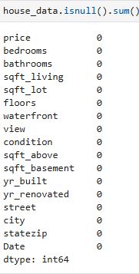

Missing Values Imputation
Before Removing Null Values:
After Removing Null Values:
Identified using isnull().sum().
Numerical: Filled with mean/median.
Categorical: Filled with mode.
Dropped rows if incomplete.

Slide 7
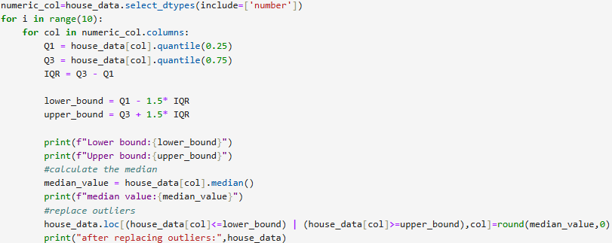
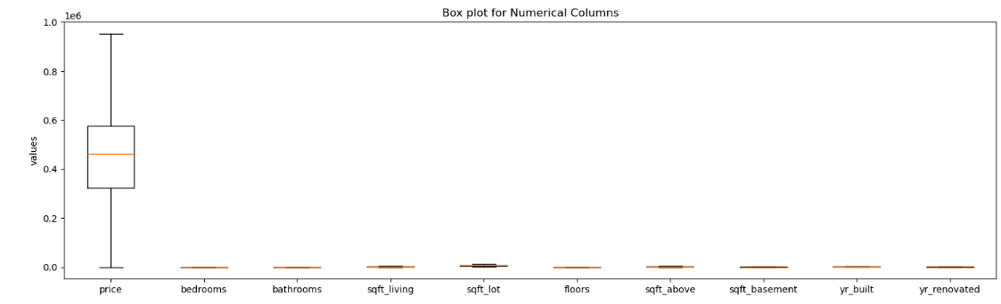
Outlier Handling
Detected via IQR and boxplots.
Removed unrealistic values .
Replaced extreme values with median or removed based on business logic.
Retained legitimate luxury homes.

Slide 8
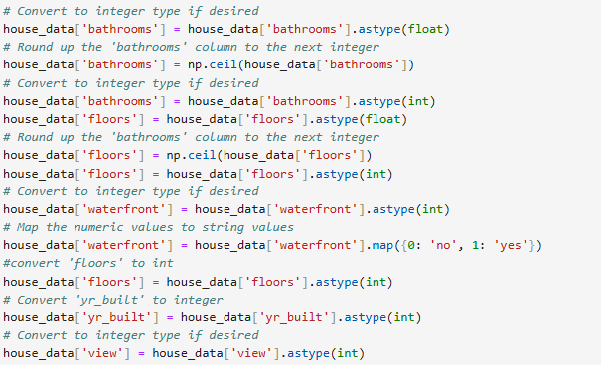
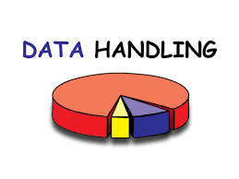
HANDLING INVALID VALUES
Replaced zero values in Columns like “yr_built” and “price” where unrealistic.
Filtered inconsistent values(example 0 bathrooms)

Slide 9
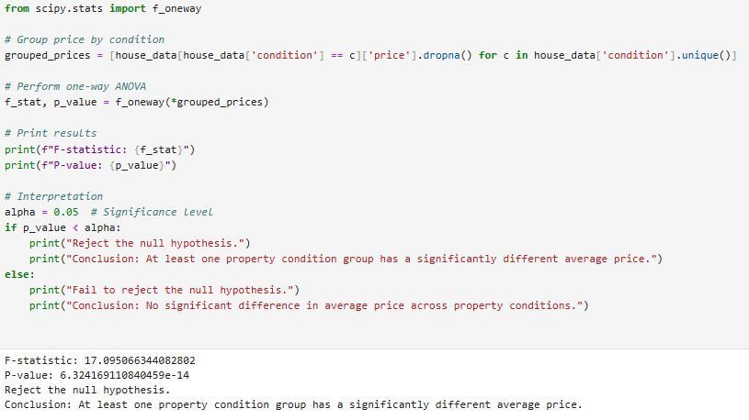
STATISTICAL ANALYSIS
One Way ANOVA Test
Tests Used:
Descriptive Statistics.
One way ANOVA test: price vs condition
Two Way t-test between Renovated house and unrenovated house.
Chi-Square between Condition and Renovation

Slide 10
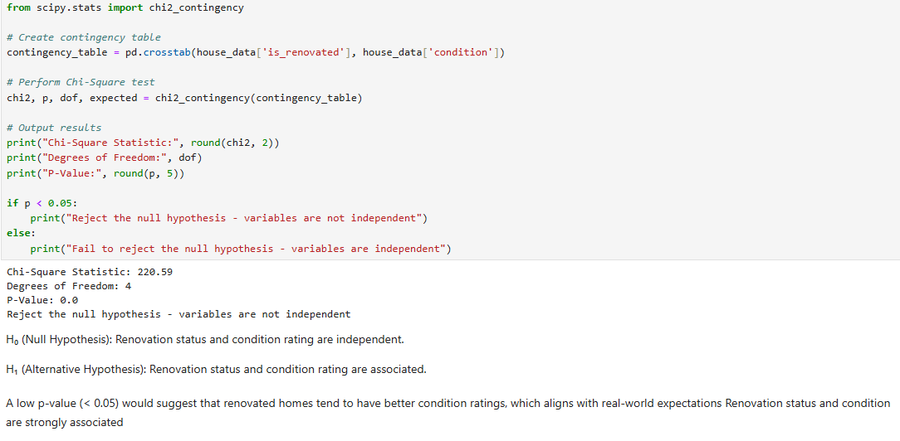
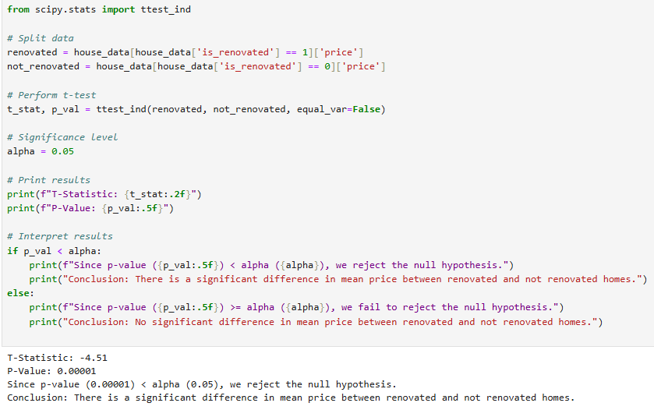
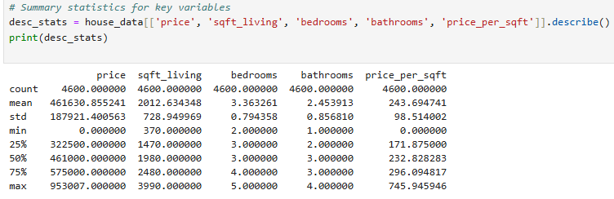
Chi Square test
Two way t-test
Descriptive Statistics

Slide 11
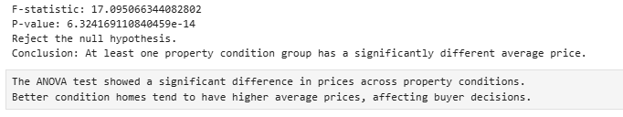
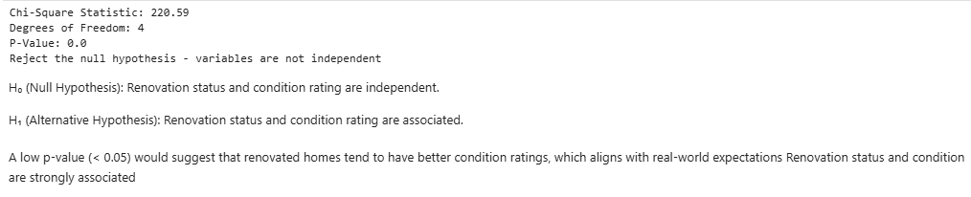
Relationships Between Variables
Larger sqft_living strongly correlates with price
Renovation, view and condition also significantly impact price
Chi-square showed renovation affects condition

Slide 12
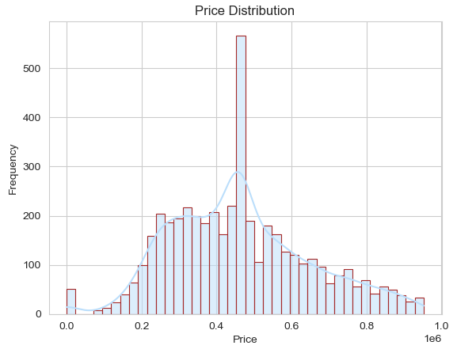
DATA VISUALIZATION
Helps identify patterns and trends visually.
Used histograms, scatter plots, heatmaps, pair plots.

Slide 13
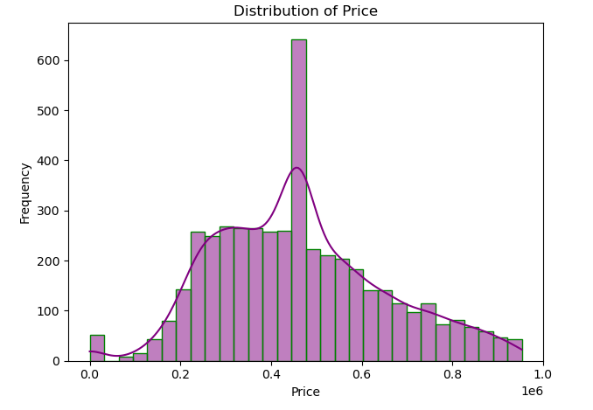
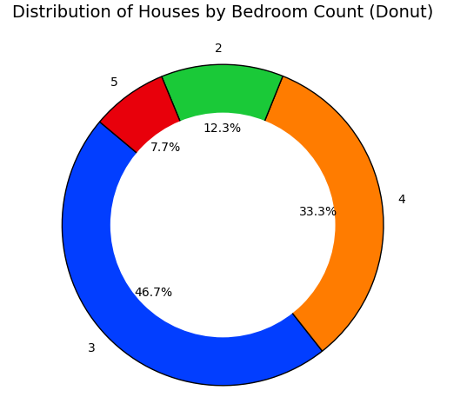
Univariate Analysis
Explored individual variables:
Price, sqft living, bedrooms, bathrooms, condition,.
Histogram for price and Donut Chart for Bedrooms

Slide 14
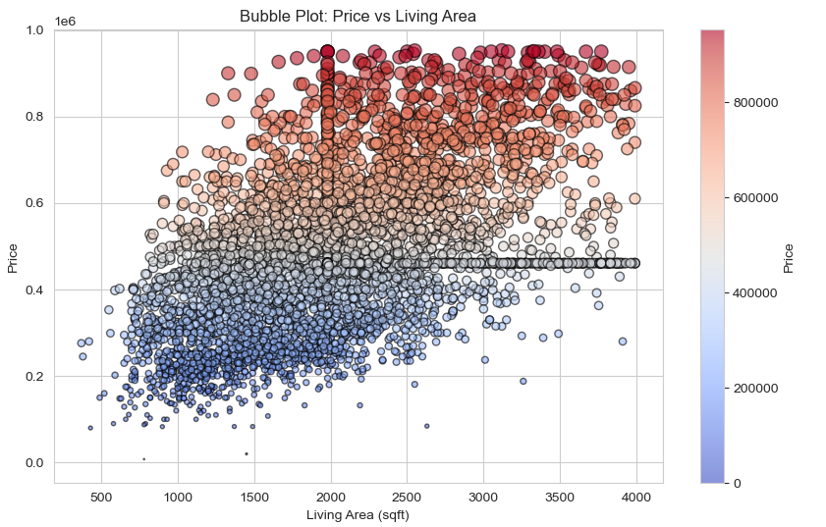
Bivariate Analysis
Explored relationships between two variables.
Used scatter plots, boxplots, correlation heatmaps.
Used for Price vs sqft_living
Used for Price vs bedroom
Used for Price vs view
Bubble sort for price vs Sqft_ living

Slide 15
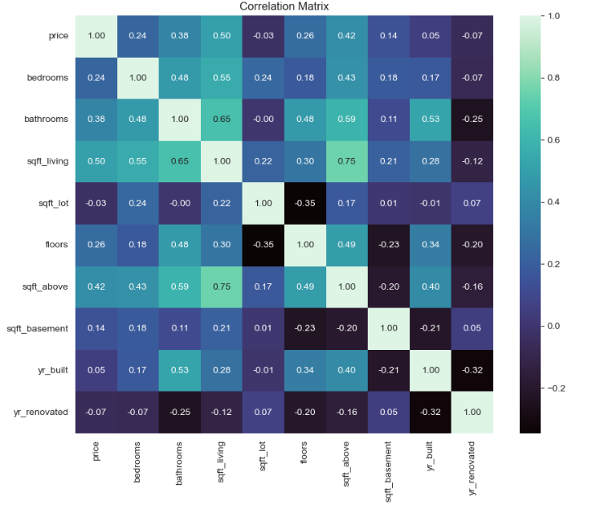
Multivariate Analysis
Examined combined influence of multiple features on price
Used for sqft_living, grade, renovation status: top price predictors.
Here I used Heat Map:

Slide 16
Conclusion and Recommendations
Recommendation:
Luxury homes affect average prices.
Future work: Add location features, apply ML models.
Homes in better condition (4–5) have higher prices.
Higher view ratings are linked to increased property prices.
Properties with 3 to 4 bedrooms show the best price-to-size ratio
Focus on homes with 3–4 bedrooms, as they offer the best price-to-size ratio.
Maintain or upgrade homes to condition ratings 4 or 5 to boost property value.
Avoid overpricing in low-demand neighborhoods; offer discounts or promotions to attract buyers.

Slide 17
THANK YOU

